Slide 1
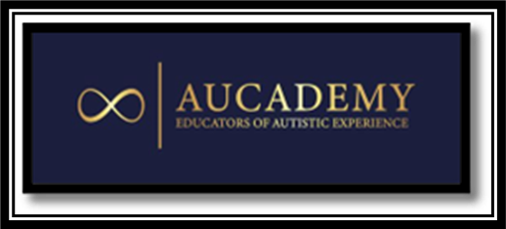
To be Autistic:
Autistic experience/to be Autistic: “[A] neurodevelopmental difference, where Autistic brains work differently to non-autistic people. ​There are as many different brains and ways of experiencing the world as there are different bodies. ​ There is a variety of Autistic people, just as there is a variety of non-autistic people, but all Autistic people share some similarities. ​
These similarities include ​differences in experience of the sensory world, ​communication, ​thinking, socialising and moving​
Dr Chloe Farahar Aucademy 2021

